Slide 1

Open Enrollment Resource
https://review.myalex.com/corpuschristi/sneakpeek

Slide 2

2023-2024 Open Enrollment
Benefit Education Session

Slide 3

What is Open Enrollment?
This is your opportunity to make plan changes, without needing a qualifying event
You can Add/Drop/Change Medical, Dental, Vision, and all other supplemental benefits
Or Add/Drop Dependents
  All supporting documents due by August 30, 2023.

Slide 4
Dates to Remember…
You must select your benefits online between:
  August 14, 2023 and August 28, 2023
New changes effective:
  October 1, 2023
New deductions on payroll check dated:
  October 13, 2023

Slide 5
What’s changing in October?

Slide 6

PLAN CHANGES
            Citicare Value Plan
Out of Pocket increase to $5,000 individual, $10,000 family
Prescription co-pay changes
            Citicare CDHP
Prescription co-pay changes

Slide 7
Prescription drug changes
CitiCare Value and CDHP Drugs on Formulary | 30*/90 Day copays
Generic Drugs | $10/$20 copay
Preferred Brand | $35/$70 copay
Non-Preferred Brand | $70/$140 copay
Specialty | $125 copay

Slide 8
Premium Rate Changes
2023-2024 Premiums | Employee Only | Employee & Spouse | Employee & Child(ren) | Employee & Family
Citicare Value | $70.34 | $285.36 | $233.47 | $402.11
Citicare CDHP | $21.00 | $142.46 | $116.56 | $200.76

Slide 9
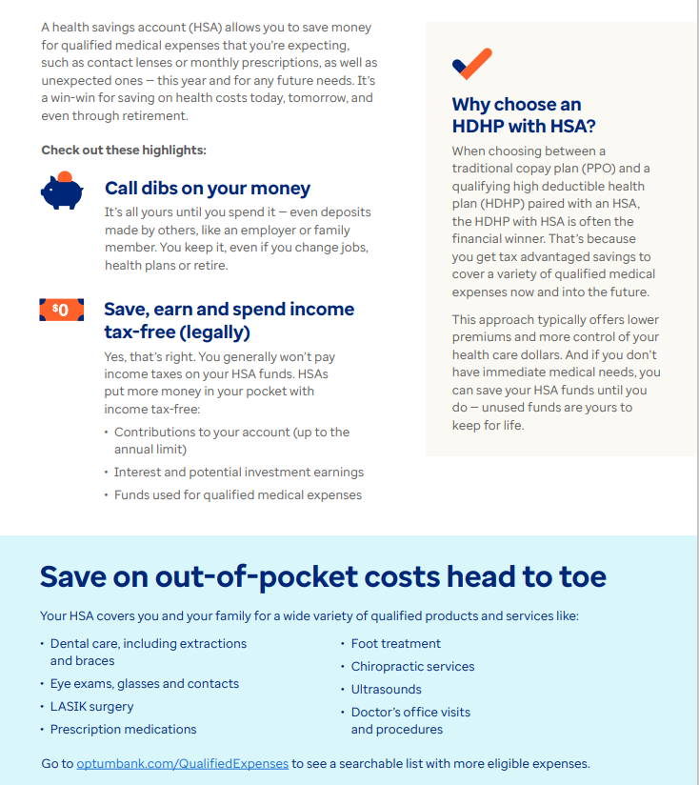
Your hsa working for you
Don’t forget that the City will contribute $1,300 or $2,600 to your HSA in October. Now is the time to confirm you contribution and make any changes.
The 2023 IRS limit is $3,850 individual, $7,750 for family and will be increasing in 2024 to $4,150 individual and $8,300 for family.

Slide 10


Available to employees, spouses and dependents over age 13 on BCBS medical plan
Online assessment helps pinpoint the right programs for you, such as:
  Stress, anxiety and worry
  Depression
  Insomnia
  Social anxiety
  Substance use
  Panic
  Resiliency

Slide 11
Medical plan highlights

Slide 12



MDLIVE
Virtual Visits
MDLive provides virtual doctoring for anyone on the current medical plans.
Only a $10 co-pay on either plan.
Remember, if you are on the CDHP Plan, you can use your HSA money!

Slide 13



Progyny fertility benefits are available to employees and spouses on the City’s medical plan.
Includes two smart cycles and Progyny Rx integrated fertility medication coverage.
To learn more, ​contact Progyny at 844-535-0694. At the prompt, enter your employer as “CORPUS”.

Slide 14


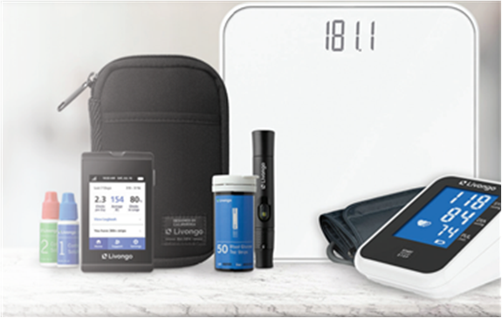
Livongo is available at no cost to employees and their family members covered on any of the City’s Medical Plans.*
By joining you will get:
All the support you need
    Personalized insights
    One-on-one coaching
    Guidance on healthy habits
Livongo for Diabetes
  Advanced blood glucose meter
  Unlimited test strips
Livongo for High Blood Pressure
  Advanced blood pressure monitor
  Easy-to-use app and dashboard
To enroll or for more information, visit join.livongo.com/CORPUS/begin
*Eligibility is dependent upon diagnosis of diabetes/high blood pressure by a medical professional.

Slide 15
Wellness program

Slide 16
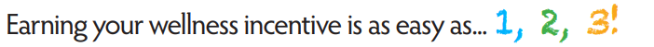


Wellness Program
  Employees on the City’s medical plan can earn a $20 per-pay-period health insurance premium discount – a savings of $520 per benefits year!
  All requirements must be completed between July 1, 2023, to June 30, 2024, to receive the discount in October 2024
To qualify for the wellness incentive:
You are required to complete Steps
Your Spouse can also earn a discount by completing Steps 1 & 2

Slide 17




Wellness Program Requirements
Here’s how to earn that discount between July 1, 2023, and June 30, 2024:
  Get an annual wellness exam. You can get your exam from any of the following:
    Your personal physician
    The Employee Health & Wellness Center
    Catapult biometric screening event
  Take the online health assessment. You can get complete this using any the following:
    BCBS
    Employee Wellness Platform (coming soon!)
  Complete all three wellness buckets*. The City offers a variety of wellness bucket (elective) activities that focus on emotional, financial, and physical health. Employees must complete at least one activity per wellness bucket.
*Employees hired mid-year have pro-rated wellness bucket requirements.

Slide 18


Employee Wellness Platform (coming soon!)
A virtual Employee Wellness Platform will become available soon to employees and spouses on a City medical plan.
This platform will have perks such as:
  Helping you to track your requirement completion progress
  A variety of convenient wellness bucket activities
  Easy access to other City Benefits and Wellness-related websites, and more!

Slide 19


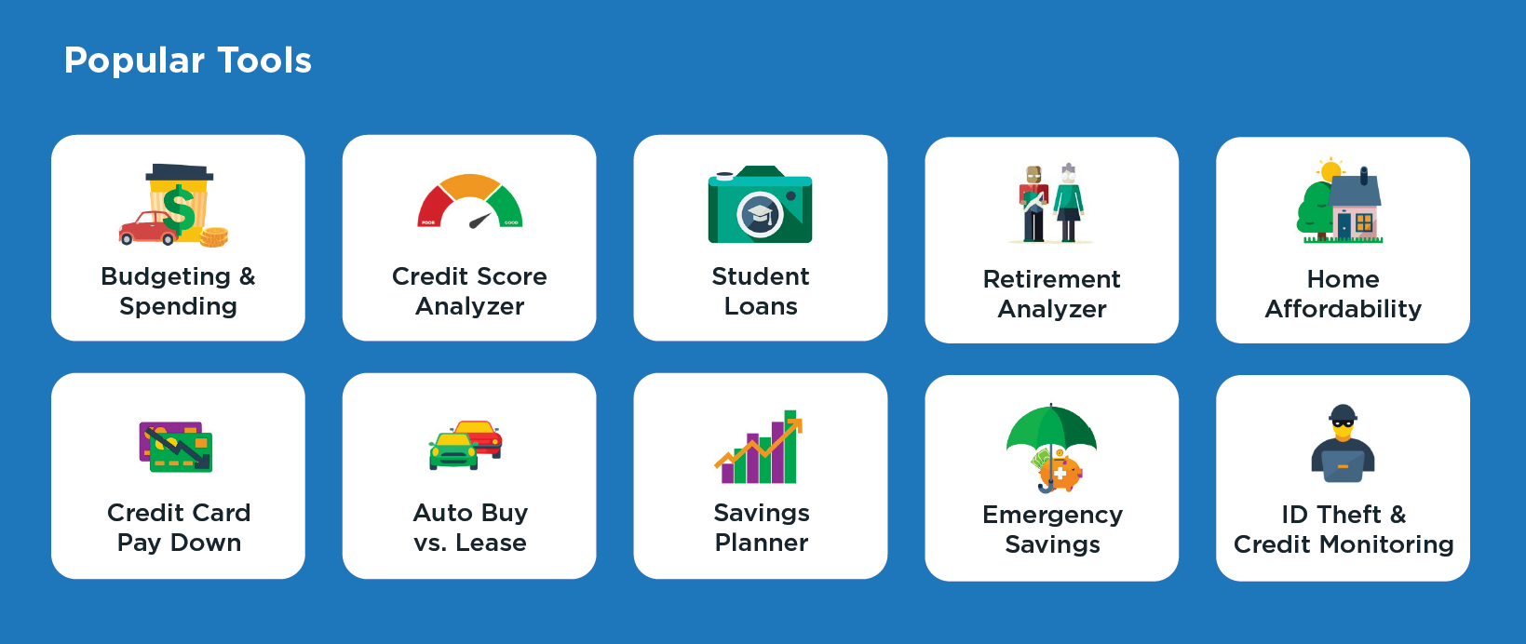
Wellness Programs
Regular full-time employees have access to 1:1 financial coaches and powerful tools to help move from surviving to thriving. Money management doesn’t require a lot of money…it just involves a little extra planning.

Slide 20



Wellness Programs
Employees and eligible dependents on a City medical plan have access to HUSK Nutrition!
Using this virtual benefit, you can meet one-on-one with Registered Dietitians, who are nutrition experts, up to six times per benefits year at no charge.
First visit is provided to benefits-eligible employees at no cost, regardless of being on a City medical plan.

Slide 21
Health and Wellness Clinic
The City offers employees a conveniently located Clinic on the first floor of City Hall next to the Lipan St. entrance.
Clinic hours are Monday through Friday from 8am to 5pm (Closed from 12pm to 1pm for lunch).
Call (361) 826-3333 to schedule an appointment.
The Clinic’s nurse practitioners can diagnose and treat common illnesses such as allergies, ear infections, strep throat and the flu.
You can utilize the clinic as your primary health care provider to manage chronic conditions like hypertension, diabetes, and high cholesterol, or receive your annual preventative exams.
Employees, retirees and dependents over age two who are enrolled in the Citicare Value Plan may visit the clinic at no charge.
All other employees and their dependents can access the clinic for a $20 fee, plus $15 for labs (if applicable).
You don’t have to be on the medical plan for this benefit. Contact the Benefits Team for your form.

Slide 22









Wellness activities take place in person and virtually! Opportunities are announced regularly via Wellness@cctexas.com and HR Liaisons.
Physical Health Financial Health Emotional Health

Slide 23

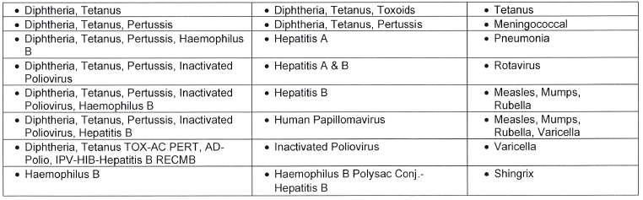
Employees and dependents on a City health plan can get a flu shot and COVID-19 vaccine at no charge at any CVS that offers immunizations*. In fact, all seasonal and non-seasonal Affordable Care Act preventative vaccines are available at CVS for no charge. See below for the complete list.
*To receive the vaccine at no charge, employees must request the CVS technician to run the claim through the pharmacy coverage, not the medical coverage.

Slide 24

Employee Assistance Program (EAP) Family Counseling Service
Our EAP, provided by Family Counseling Service, is available to all employees, their spouses and their dependent children.
The City pays for up to three confidential counseling visits per family per fiscal year, for issues related to work, relationships, abuse, depression/anxiety, grief/loss and alcohol/drug dependency.
Any visits after that are based on a sliding scale pay rate. They are in network with BCBS so you can use your medical coverage too.
To schedule an appointment, call (361) 852-9665, Option 3, or email appointments@fcscb.org.
Note: Employees must notify Family Counseling Service that they work with the City to take advantage of this benefit.

Slide 25
Tobacco Surcharge
        We want to provide employees an extra incentive for making the healthy choice
        not to use tobacco and nicotine products.
        Effective October 1, 2023, all civilian employees and/or spouses enrolled in any General City health plan who use tobacco will be subject to a surcharge of $20 per pay period per tobacco user on their health insurance premiums.
        To avoid the surcharge, tobacco users have the alternative to enroll in and complete a Blue Cross Blue Shield (BCBS) tobacco cessation program at no additional cost or through a tobacco cessation program supervised by a licensed doctor (M.D. or D.O.) at their own expense.
        The surcharge will be removed if official documentation is submitted after cessation program completion to Wellness@cctexas.com. Tobacco cessation programs will only apply to the plan year in which it was completed.
        For more details, please refer to the Benefit Guide, page 9, and HR 48.0 Tobacco Use Surcharge policy.

Slide 26
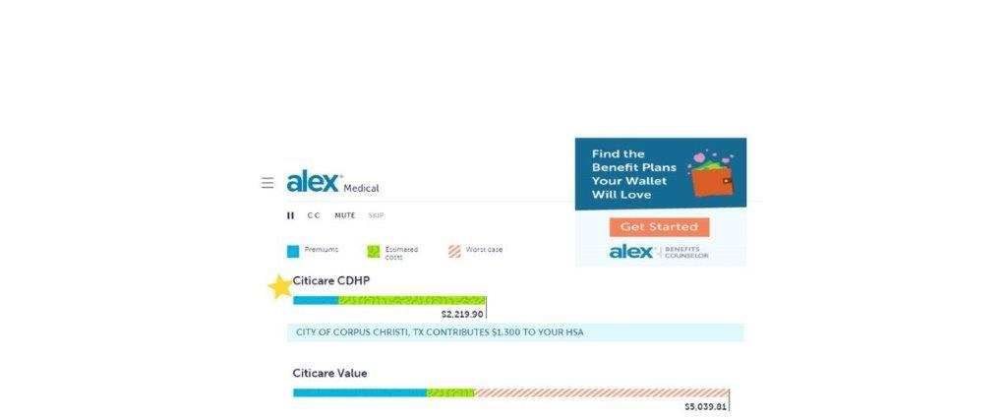
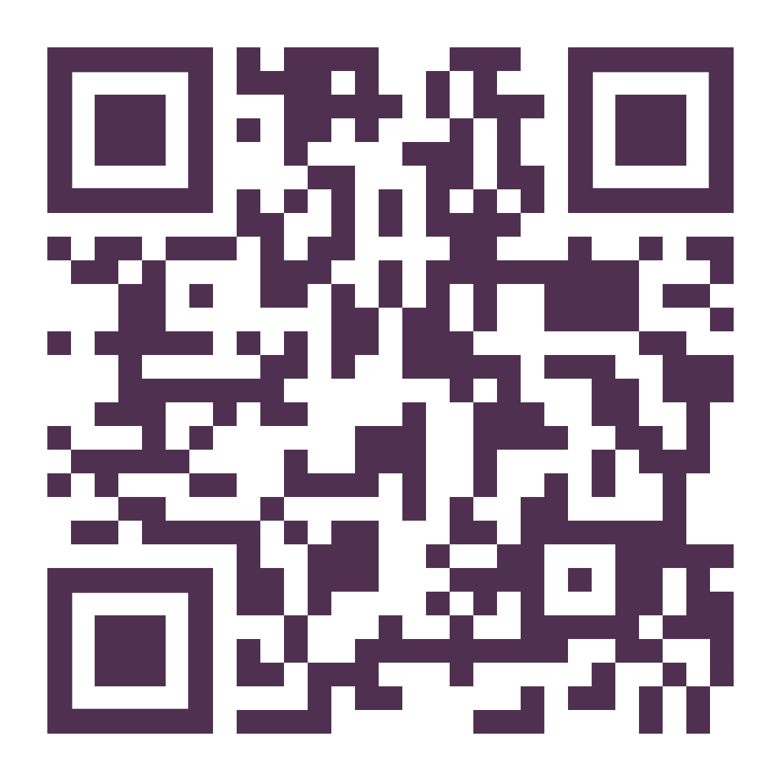
Meet Alex
Get help choosing your benefits! Alex will help you find the best fit benefit plans for you & family!
My Alex QR Code

Slide 27


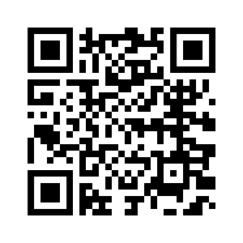
How to Enroll
My Alex - Get help choosing your benefits!
Alex will help you find the best fit benefit plans
for you & your family!
OR
Contact the Help Desk
(826-3766),
to reset your password if needed

Slide 28
How to Enroll
Go directly to www.benefitscc.org
Click on Employee Self Service and Log in to Infor
Click on Current benefits to view your current elections
Accessible 24 hours during Open Enrollment (August 14-August 28)
Remember unlimited access, don’t wait until the last minute
Click on Benefits Enrollment
Continue to click through until you receive the message “Congratulations, your enrollment is complete.”
We encourage you to print out your elections as your confirmation in case there are any errors.
To view the Open Enrollment Guides and Rates go to: www.benefitscc.org

Slide 29
Don’t Forget!
If you add dependents, submit documentation to HR by August 30, 2023
If you want to elect Flex (FSA), you must re-enroll even if you had it last year.
If you qualify for the HSA under CDHP, turn in your Optum form to HR by August 30, 2023
If you add/increase your Disability or Life insurance, turn in your Evidence of Insurability to HR by August 30, 2023.
Enrollment is ONLY open August 14 to August 28
for you to make selections
Otherwise, you may only make changes during the year within 30 days of a qualifying event.
Examples: Marriage, Divorce, Birth of a child, Spouse changes employment

