Slide 1


Benefits Sneak Peek — ALEX (myalex.com)

Slide 2


2024-2025 Open Enrollment
Benefit Education Session

Slide 3


What is Open Enrollment?
This is your opportunity to make plan changes, without needing a qualifying event
You can Add/Drop/Change Medical, Dental, Vision, and all other supplemental benefits or Add/Drop Dependents
This is also a good time to review your personal information such as your current address, phone number and beneficiaries
All supporting documents due by August 30, 2024.

Slide 4
Dates to Remember…
You must select your benefits online between:
  August 12, 2024 and August 23, 2024
New changes effective:
  October 1, 2024
New deductions on payroll check dated:
  October 11, 2024

Slide 5
What’s changing in October?

Slide 6

PLAN CHANGES
            Citicare Fire Plan
No longer available
            Citicare CDHP
Only option available
Slight increase to premiums
Slight increase to deductible due to IRS Regulations

Slide 7

Premium Rate Change
Current:
New:
See Page 4 of the
Benefit Guide
BIWEEKLY MEDICAL RATES
Coverage | Employee Only | Employee & Spouse | Employee & Child(ren) | Employee & Family
Fire CDHP | $0 | $127.09 | $99.06 | $211.60
BIWEEKLY MEDICAL RATES
Coverage | Employee Only | Employee & Spouse | Employee & Child(ren) | Employee & Family
Fire CDHP | $0 | $133.44 | $104.01 | $222.18

Slide 8
Deductible Change
Current:
New:
See Page 4 of the
Benefit Guide
FIRE CDHP
In Network/Out of Network
Deductible | $3,000/$6,000
Out-of-Pocket Max | $3,000/$6,000
FIRE CDHP
In Network/Out of Network
Deductible | $3,200/$6,000
Out-of-Pocket Max | $3,200/$6,000

Slide 9
Retiree Premiums
Current:
New:
Fire CDHP | Monthly Premium | Assoc Credit | Total
Retiree<65 Only | $252.56 | $430.29 | $682.85
Retiree<65+Spse<65 | $1,034.79 | $430.29 | $1,465.08
Retiree<65+Children | $874.74 | $430.29 | $1,305.03
Retiree<65+Family | $1,517.61 | $430.29 | $1,947.90
Fire CDHP | Monthly Premium | Assoc Credit | Total
Retiree<65 Only | $175.20 | $507.65 | $682.85
Retiree<65+Spse<65 | $957.43 | $507.65 | $1,465.08
Retiree<65+Children | $797.38 | $507.65 | $1,305.03
Retiree<65+Family | $1,440.25 | $507.65 | $1,947.90

Slide 10
HSA City Contribution
            All Employees Enrolled in CDHP eligible
            (unless otherwise noted)
            $1,600 for Employee Only Coverage
            $2,600 for Employee + Dependent Coverage
            Additional $2,000 per Employee for FY25 deposited in either October 2024 or January 2025

Slide 11
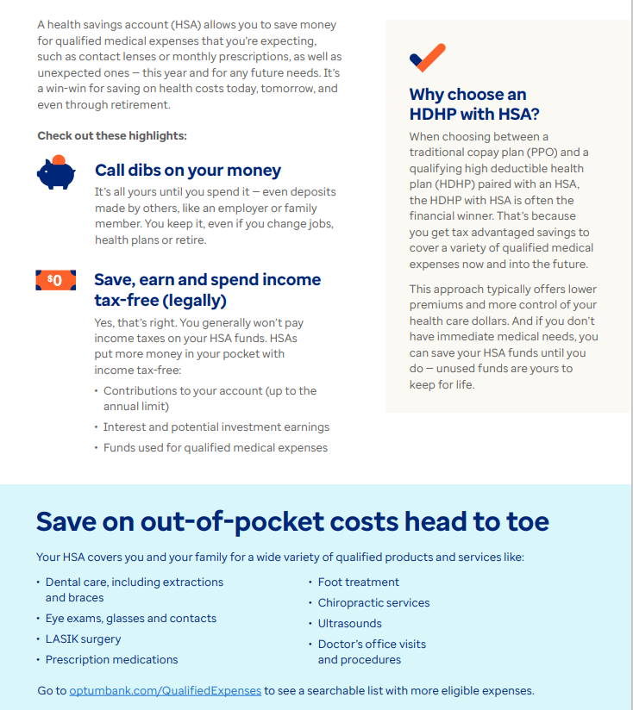
Your hsa working for you
Triple Tax Advantage
  Pre-Tax Contribution
  Interest earned on HSA balance
  Use tax-free for qualified medical expenses
No Use It or Lose It Rule
2024 IRS Limit
  $4,150 Individual; $8,300 Family
2025 IRS Limit
  $4,300 Individual; $8,550 Family

Slide 12
Medical Plan Highlights

Slide 13



MDLIVE
Virtual Visits
MDLive provides virtual doctoring for anyone on the current medical plan.
$10 co-pay per visit
HSA-eligible expense

Slide 14


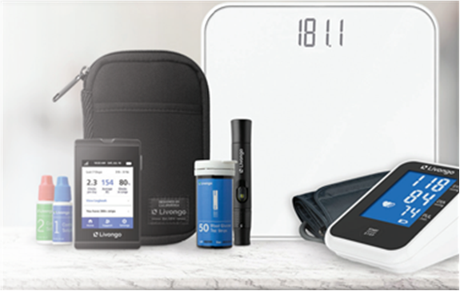
Livongo is available at no cost to employees and their family members covered on any of the City’s Medical Plans.*
By joining you will get:
All the support you need
    Personalized insights
    One-on-one coaching
    Guidance on healthy habits
Livongo for Diabetes
  Advanced blood glucose meter
  Unlimited test strips
Livongo for High Blood Pressure
  Advanced blood pressure monitor
  Easy-to-use app and dashboard
To enroll or for more information, visit TeladocHealth.com/Smile/CORPUS
*Eligibility is dependent upon diagnosis of diabetes/high blood pressure by a medical professional.

Slide 15


Available to employees, spouses and dependents over age 13 on BCBS medical plan
Online assessment helps pinpoint the right programs for you, such as:
  Stress, anxiety and worry
  Depression
  Insomnia
  Social anxiety
  Substance use
  Panic
  Resiliency

Slide 16



Progyny fertility benefits are available to employees and spouses on the City’s medical plan.
Includes two smart cycles and Progyny Rx integrated fertility medication coverage.
To learn more, ​contact Progyny at 844-535-0694. At the prompt, enter your employer as “CORPUS”.

Slide 17
Employee Wellness Program

Slide 18
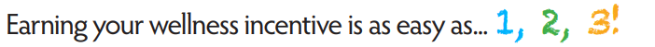

Wellness Program
Employees on the City’s medical plan can earn a $20 per-pay-period health insurance premium discount – a savings of $520 per benefits year!
  Note: The discount will not reduce your premium to below $0.
All requirements must be completed between July 1, 2024, to June 30, 2025, to receive the discount in October 2025
To qualify for the wellness incentive:
You are required to complete Steps
Your spouse can also earn a discount by completing Step

Slide 19





Wellness Program Requirements
Here’s how to earn that discount between July 1, 2024, and June 30, 2025:
  Get an annual wellness exam. You can get your exam from any of the following:
    Your personal physician
    The Employee Health & Wellness Center
    Catapult biometric screening event
  Take the online health assessment. You can get complete this using any the following:
    Employee Wellness Platform
    BCBS
  Complete all three wellness buckets*. The City offers a variety of wellness bucket (elective) activities that focus on emotional, financial, and physical health. Employees must complete at least one activity per wellness bucket.
*Employees hired mid-year have pro-rated wellness bucket requirements.

Slide 20


Employee Wellness Platform
A virtual Employee Wellness Platform is available to employees and spouses on a City medical plan. You can use Wellable for the following benefits:
  Helping you to track your requirement completion progress
  A variety of convenient wellness bucket activities
  Monthly giveaways and friendly competition
  Easy access to other City Benefits and Wellness-related websites, and more!

Slide 21


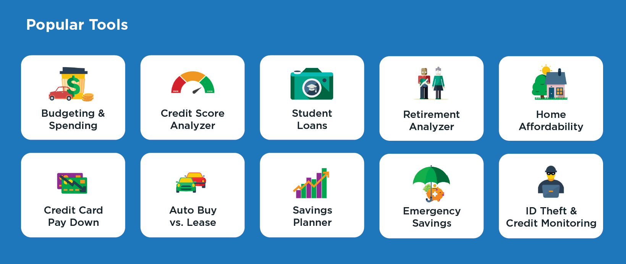
Wellness Programs
Regular full-time employees have access to 1:1 financial coaches and powerful tools to help move from surviving to thriving. Money management doesn’t require a lot of money…it just involves a little extra planning.

Slide 22


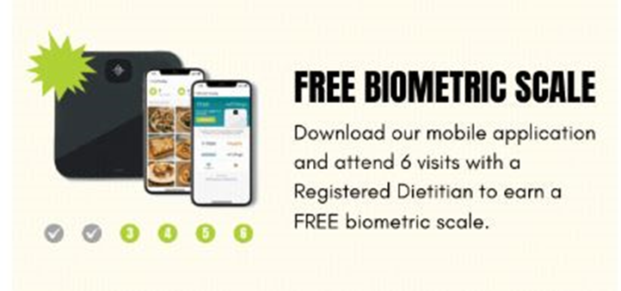
Wellness Programs
Employees and eligible dependents on a City medical plan have access to HUSK Nutrition!
Using this virtual benefit, you can meet one-on-one with Registered Dietitians, who are nutrition experts, up to six times per benefits year at no charge.
First visit is provided to benefits-eligible employees at no cost, regardless of being on a City medical plan.

Slide 23









Wellness activities take place in person and virtually! Opportunities are announced regularly via Wellness@cctexas.com and HR Liaisons.
Physical Health Financial Health Emotional Health

Slide 24


Blue Points
By using the BCBS Well onTarget program, you can earn Blue Points to cash in on exciting merchandise in the online catalog, including items such as smart watches, kitchen tools, baby car seats, strollers, fitness equipment, designer purses, and more. Examples of ways to earn points include:
  Complete the online health assessment and earn 2,500 points.
  Connect a fitness device or mobile app and earn 2,675 points, then earn 55 points per day for keeping it connected.
  Complete all of the lessons in any one of the self-management programs to earn 1,000 points quarterly.
  Enroll in the BCBS Fitness Program and earn 2,500 points annually.
Blue Points are only available to employees and spouses insured on the City's health plans. To get started, log in to your member account on www.bcbstx.com, click the Wellness tab in the top menu, and select Well onTarget.

Slide 25
Health and Wellness Clinic
The City offers employees a conveniently located Clinic on the first floor of City Hall next to the Lipan St. entrance.
Clinic hours are Monday through Friday from 8am to 5pm (Closed from 12pm to 1pm for lunch).
Call (361) 826-3333 to schedule an appointment.
The Clinic’s nurse practitioners can diagnose and treat common illnesses such as allergies, ear infections, strep throat and the flu.
You can utilize the clinic as your primary health care provider to manage chronic conditions like hypertension, diabetes, and high cholesterol, or receive your annual preventative exams.
Employees, their dependents and retirees enrolled in the Fire CDHP can access the clinic for a $20 fee, plus $15 for labs (if applicable).
You don’t have to be on the medical plan for this benefit. Contact the Benefits Team for your form.

Slide 26

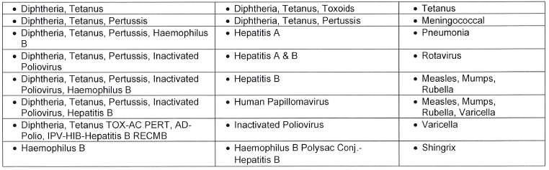
Employees and dependents on a City health plan can get a flu shot and COVID-19 vaccine at no charge at any CVS that offers immunizations*. In fact, all seasonal and non-seasonal Affordable Care Act preventative vaccines are available at CVS for no charge. See below for the complete list.
*To receive the vaccine at no charge, employees must request the CVS technician to run the claim through the pharmacy coverage, not the medical coverage.

Slide 27

Employee Assistance Program (EAP)
Family Counseling Service
Our EAP, provided by Family Counseling Service, is available to all employees, their spouses and their dependent children.
The City pays for up to three confidential counseling visits per family per fiscal year, for issues related to work, relationships, abuse, depression/anxiety, grief/loss and alcohol/drug dependency.
Any visits after that are based on a sliding scale pay rate. They are in network with BCBS so you can use your medical coverage too.
To schedule an appointment, call (361) 852-9665, Option 3, or email appointments@fcscb.org.
Note: Employees must notify Family Counseling Service that they work with the City to take advantage of this benefit.

Slide 28
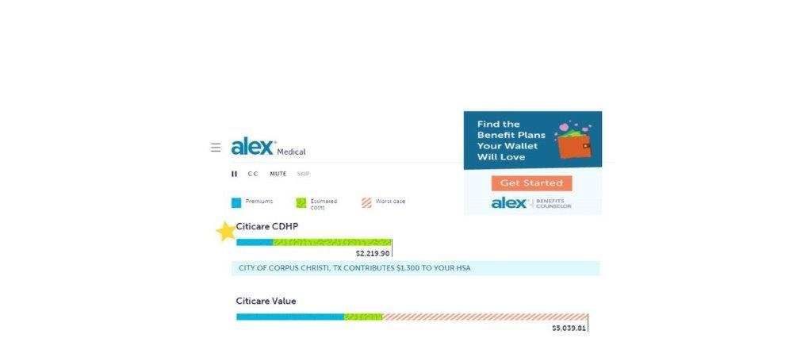
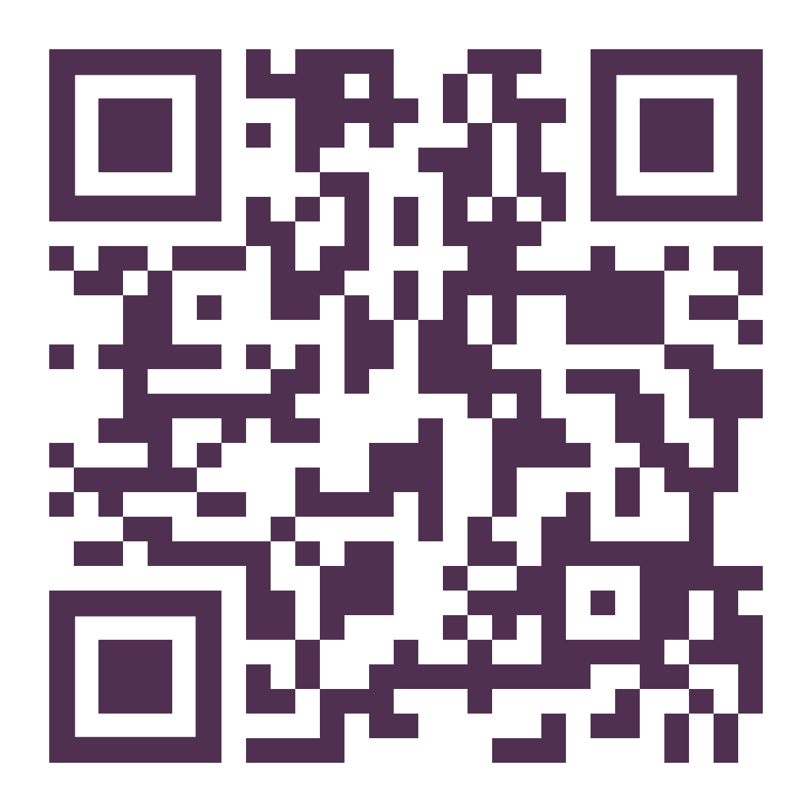
Meet Alex
Get help choosing your benefits! Alex will help you find the best fit benefit plans for you & family!
My Alex QR Code

Slide 29


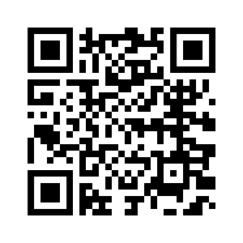
How to Enroll
My Alex - Get help choosing your benefits!
Alex will help you find the best fit benefit plans
for you & your family!
OR
Contact the Help Desk
(826-3766),
to reset your password if needed

Slide 30
How to Enroll
Go directly to www.benefitscc.org
Click on Employee Self Service and Log in to Infor
Click on Current benefits to view your current elections
Accessible 24 hours during Open Enrollment (August 12-August 23)
Remember unlimited access, don’t wait until the last minute
Click on Benefits Enrollment
Continue to click through until you receive the message “Congratulations, your enrollment is complete.”
We encourage you to print out your elections as your confirmation in case there are any errors.
To view the Open Enrollment guides and eates go to: www.benefitscc.org

Slide 31
Don’t Forget!
If you add dependents, submit documentation to HR by August 30, 2024
If you want to elect Flex (FSA), you must re-enroll even if you had it last year.
If you qualify for the HSA under CDHP, turn in your Optum form to HR by August 30, 2024
If you add/increase your Disability or Life insurance, make an appointment with Benefits to review and turn in your Evidence of Insurability to HR by August 30, 2024.
Enrollment is ONLY open August 12 to August 23
for you to make selections
Otherwise, you may only make changes during the year within 30 days of a qualifying event.
Examples: Marriage, Divorce, Birth of a child, Spouse changes employment

