Slide 1
Benefits Sneak Peek — ALEX (myalex.com)

Slide 2
2024-2025 Open Enrollment
Benefit Education Session

Slide 3
What is Open Enrollment?
This is your opportunity to make plan changes, without needing a qualifying event
You can Add/Drop/Change Medical,and all other supplemental benefits or Add/Drop Dependents
All supporting documents due by August 30, 2024.

Slide 4
Dates to Remember…
You must select your benefits online between:
August 12, 2024 and August 23, 2024
New changes effective:
October 1, 2024
New deductions on payroll check dated:
October 11, 2024

Slide 5
Medical Plan Highlights

Slide 6
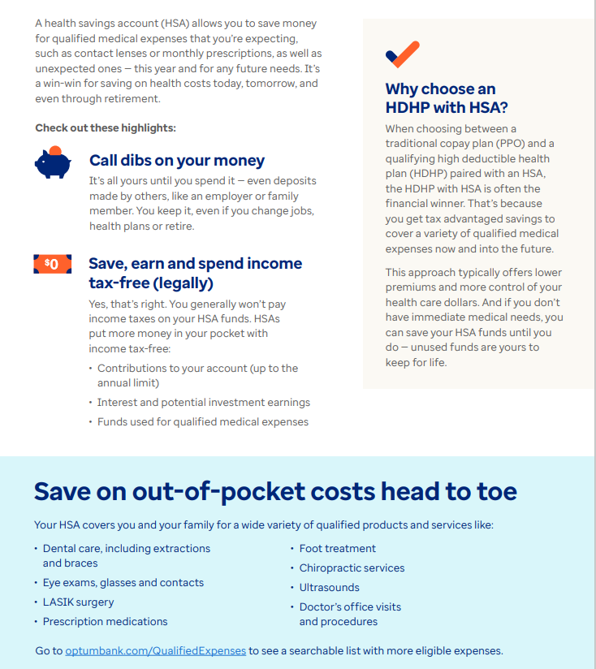
Your HSA Working For You
Don’t forget that the City will contribute $1,600 to your HSA in October. Now is the time to confirm your contribution and make any changes.
The 2024 IRS limit is $4,150 individual, $8,300 for family and will be increasing in 2025 to $4,150 individual and $8,300 for family.
The City will make an additional one-time contribution of $2,000 to your HSA, to be paid out in January 2025.

Slide 7
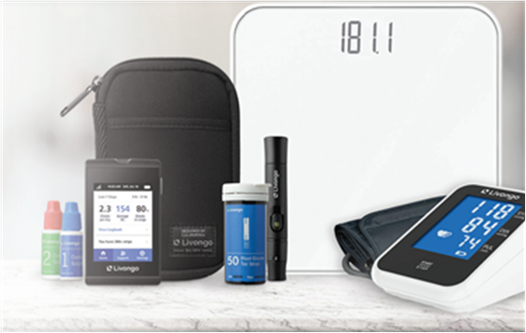
Livongo is available at no cost to employees and their family members covered on any of the City’s Medical Plans.*
By joining you will get:
All the support you need
Personalized insights
One-on-one coaching
Guidance on healthy habits
Livongo for Diabetes
Advanced blood glucose meter
Unlimited test strips
Livongo for High Blood Pressure
Advanced blood pressure monitor
Easy-to-use app and dashboard
To enroll or for more information, visit TeladocHealth.com/Smile/CORPUS
*Eligibility is dependent upon diagnosis of diabetes/high blood pressure by a medical professional.

Slide 8
MDLIVE Virtual Visits
MDLive provides virtual doctoring for anyone on the current medical plan.
Only a $10 co-pay per visit.
HSA-eligible expense

Slide 9
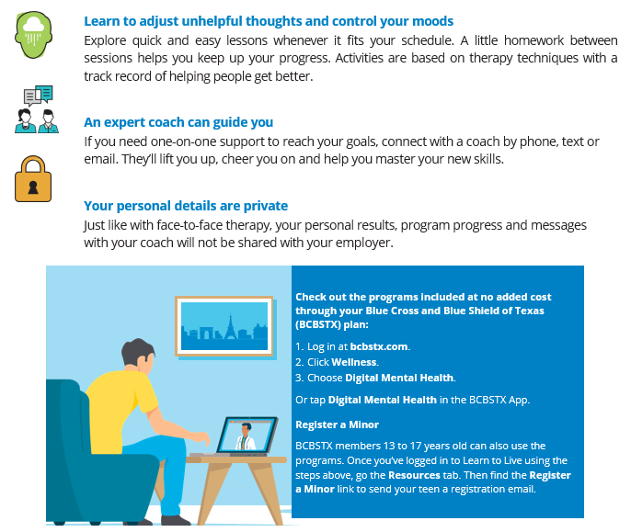
Available to employees, spouses and dependents over age 13 on BCBS medical plan
Online assessment helps pinpoint the right programs for you, such as:
Stress, anxiety and worry
Depression
Insomnia
Social anxiety
Substance use
Panic
Resiliency

Slide 10
Progyny fertility benefits are available to employees and spouses on the City’s medical plan.
Includes two smart cycles and Progyny Rx integrated fertility medication coverage.
To learn more, ​contact Progyny at 844-535-0694. At the prompt, enter your employer as “CORPUS”.

Slide 11
Wellness Program Offerings

Slide 12
Employee Wellness Platform
A virtual Employee Wellness Platform is available to all employees and spouses on a City medical plan.
This platform has perks such as:
A variety of wellness activities
Monthly giveaways and friendly competition
Easy access to Benefits & Wellness division resources

Slide 13
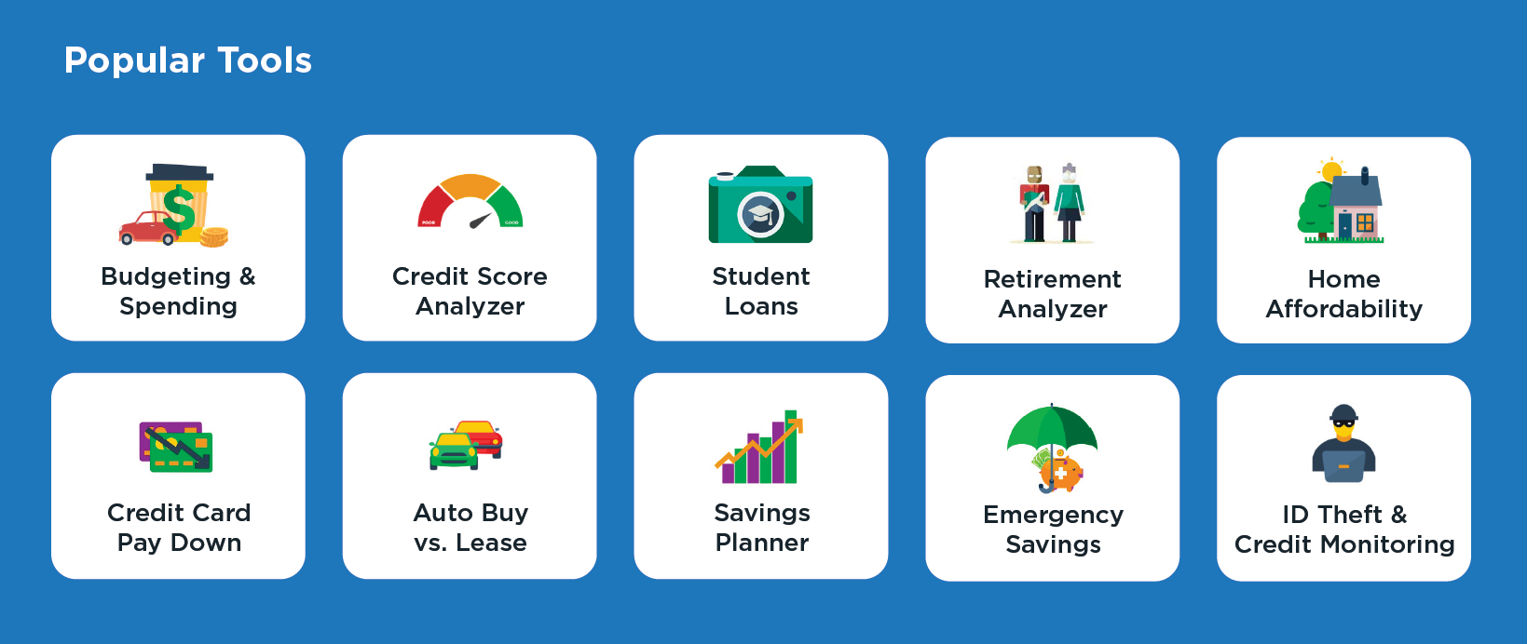
Wellness Program Offerings
Regular full-time employees have access to 1:1 financial coaches and powerful tools to help move from surviving to thriving. Money management doesn’t require a lot of money…it just involves a little extra planning.

Slide 14
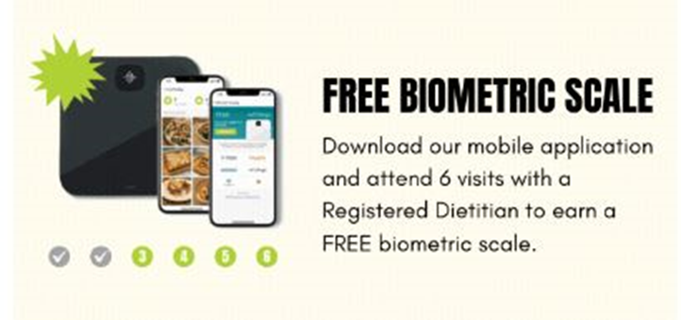
Wellness Program Offerings
Employees and eligible dependents on a City medical plan have access to HUSK Nutrition!
Using this virtual benefit, you can meet one-on-one with Registered Dietitians, who are nutrition experts, up to six times per benefits year at no charge.
First visit is provided to benefits-eligible employees at no cost, regardless of being on a City medical plan.

Slide 15
Wellness activities take place in person and virtually! Opportunities are announced regularly via Wellness@cctexas.com and HR Liaisons.
Physical Health Financial Health Emotional Health

Slide 16
Blue Points
By using the BCBS Well onTarget program, you can earn Blue Points to cash in on exciting merchandise in the online catalog, including items such as smart watches, kitchen tools, baby car seats, strollers, fitness equipment, designer purses, and more. Examples of ways to earn points include:
Complete the online health assessment and earn 2,500 points.
Connect a fitness device or mobile app and earn 2,675 points, then earn 55 points per day for keeping it connected.
Complete all of the lessons in any one of the self-management programs to earn 1,000 points quarterly.
Enroll in the BCBS Fitness Program and earn 2,500 points annually.
Blue Points are only available to employees and spouses insured on the City's health plans. To get started, log in to your member account on www.bcbstx.com, click the Wellness tab in the top menu, and select Well onTarget.

Slide 17
Health and Wellness Clinic
The City offers employees a conveniently located Clinic on the first floor of City Hall next to the Lipan St. entrance.
Clinic hours are Monday through Friday from 8am to 5pm (Closed from 12pm to 1pm for lunch).
Call (361) 826-3333 to schedule an appointment.
The Clinic’s nurse practitioners can diagnose and treat common illnesses such as allergies, ear infections, strep throat and the flu.
You can utilize the clinic as your primary health care provider to manage chronic conditions like hypertension, diabetes, and high cholesterol, or receive your annual preventative exams.
Employees, their dependents and retirees enrolled in the CDHP Public Safety Plan can access the clinic for a $20 fee, plus $15 for labs (if applicable).
You don’t have to be on the medical plan for this benefit. Contact the Benefits Team for your form.

Slide 18
Employees and dependents on a City health plan can get a flu shot and COVID-19 vaccine at no charge at any CVS that offers immunizations*. In fact, all seasonal and non-seasonal Affordable Care Act preventative vaccines are available at CVS for no charge. See below for the complete list.
*To receive the vaccine at no charge, employees must request the CVS technician to run the claim through the pharmacy coverage, not the medical coverage.

Slide 19
Employee Assistance Program (EAP) Family Counseling Service
Our EAP, provided by Family Counseling Service, is available to all employees, their spouses and their dependent children.
The City pays for up to three confidential counseling visits per family per fiscal year, for issues related to work, relationships, abuse, depression/anxiety, grief/loss and alcohol/drug dependency.
Any visits after that are based on a sliding scale pay rate. They are in network with BCBS so you can use your medical coverage too.
To schedule an appointment, call (361) 852-9665, Option 3, or email appointments@fcscb.org.
Note: Employees must notify Family Counseling Service that they work with the City to take advantage of this benefit.

Slide 20
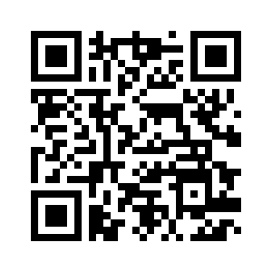
Meet Alex
Get help choosing your benefits! Alex will help you find the best fit benefit plans for you & your family!
My Alex QR Code
My Alex QR Code

Slide 21
How to Enroll
Go directly to www.benefitscc.org
Click on Employee Self Service and Log in to Infor
Click on Current benefits to view your current elections
Accessible 24 hours during Open Enrollment (August 12-August 23)
Remember unlimited access, don’t wait until the last minute
Click on Benefits Enrollment
Continue to click through until you receive the message “Congratulations, your enrollment is complete.”
We encourage you to print out your elections as your confirmation in case there are any errors.
To view the Open Enrollment guides and eates go to: www.benefitscc.org

Slide 22
Don’t Forget!
If you add dependents, submit documentation to HR by August 30, 2024
If you want to elect Flex (FSA), you must re-enroll even if you had it last year.
If you qualify for the HSA under CDHP, turn in your Optum form to HR by August 30, 2024
If you add/increase your Disability or Life insurance, turn in your Evidence of Insurability to HR by August 30, 2024.
Enrollment is ONLY open August 12 to August 23
for you to make selections
Otherwise, you may only make changes during the year within 30 days of a qualifying event. Examples: Marriage, Divorce, Birth of a child, Spouse changes employment

